Slide 2
Emergency Medical
Technician
One-year program
)

Slide 3
SCHEDULE
First day of Class:
Wednesday, August 16, 2023
GateWay @ SWSC
3000 N. Dysart Road, Avondale, AZ 85392
Monday - Thursday
1:00-3:00 PM
OR
2:00-4:00 PM
GateWay @ Deer Valley
2931 W. Bell Rd., Phoenix, AZ 85053
Monday - Thursday
1:00-3:00 PM
*Students are dropped if not present on first day of class and at the correct session/location.

Slide 4
COURSES BY SEMESTER
Fall ‘23
ESP 180 College/Career Readiness
EMC 101 CPR/Basic Cardiac Life Support
Articulates with EMT 101
EMC 102 Emergency Medical Responder
Articulates with EMT 102AB
Spring ‘24
EMC 104 Basic Emergency Medical Technology
Articulates with:
EMT 104 Emergency Medical Technician
EMT 104AB Applied Practical Studies for Emergency Medical Technology
EMT 104LL Emergency Medical Technology Practicum
Students enrolled in the Emergency Medical Technology program must attend class during the dates required. GWCC schedule does not match high school schedules (Fall and Spring Break).

Slide 5
COLLEGE REGISTRATION
First day of Class:
Wednesday, August 16, 2023
Parents received individual emails/phone calls re incomplete registration with GateWay Community College
ALL students are registered with West-MEC
ALL students MUST also be registered with GateWay by 1st day of school
Parents/students MUST contact GWCC to finalize college registration: 602-286 8203

Slide 6
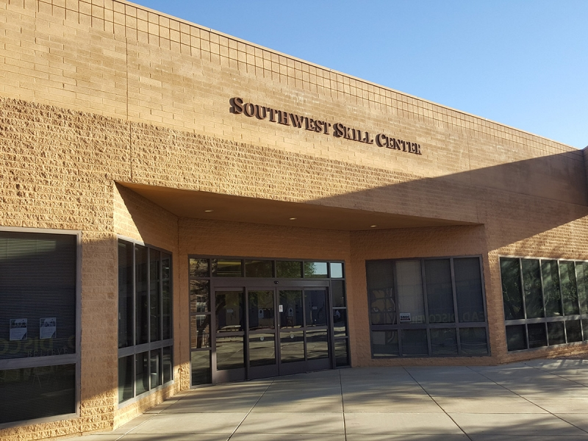
LOCATION
On the campus of EMCC, Southwest Skill Center Building

Slide 7
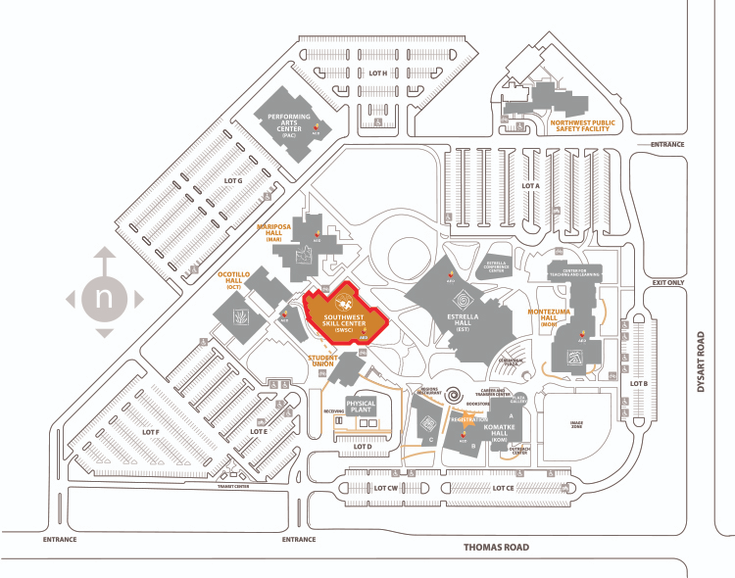
LOCATION

Slide 8
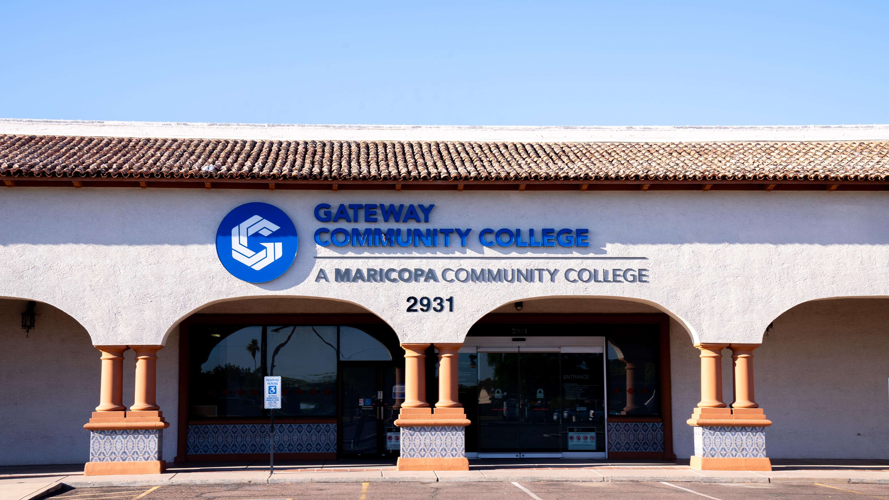
LOCATION
Gateway Community College – 2931 W Bell Road

Slide 9
TUITION - PLEASE NOTE
West-MEC pays the GWCC college tuition for in-state students, but the tuition amount will remain on the individual student’s account until fiscal processes are complete between West-MEC and GWCC offices.
A tuition bill may appear on the student’s GWCC account and student center, along with email notification from the college for tuition due.
PLEASE IGNORE THESE MESSAGES AND BALANCE IF THEY APPEAR IN THE STUDENT ACCOUNT AT ANYTIME DURING THE FALL AND SPRING SEMESTER.
All student accounts for the West-MEC EMT cohort are coded as third party billing, and the student/parent is not responsible for the tuition.

Slide 10
ATTENDANCE
Attendance is a valued employability skill.
Attendance is mandatory each day.
Any absence in excess of 10 hours (including tardies*) may be a reason for dismissal.
up to 2 hours may be missed in EMT 102
up to 8 hours may be missed in EMT 104
Absence Notification:
Notify instructor AND
Call West-MEC within 24 hours of absence:
(623) 772-4234

Slide 11
CALENDAR
West-MEC calendar differs from high school calendar.
Please follow West-MEC and GateWay calendar for EMT schedule.

Slide 12
DRESS CODE
The Program Uniform is as follows:
Uniform T-Shirts
ID Badge (high school and college)
Navy Blue Duty Pants (no shorts)
Black Belt – Utility Type – Plain Buckle
Black Duty Shoes/Boots (Safety-Toe)
Analogue Wrist Watch w Seconds Hand (NO smartwatches)
Students must purchase items and be in uniform for the first day of class.

Slide 13
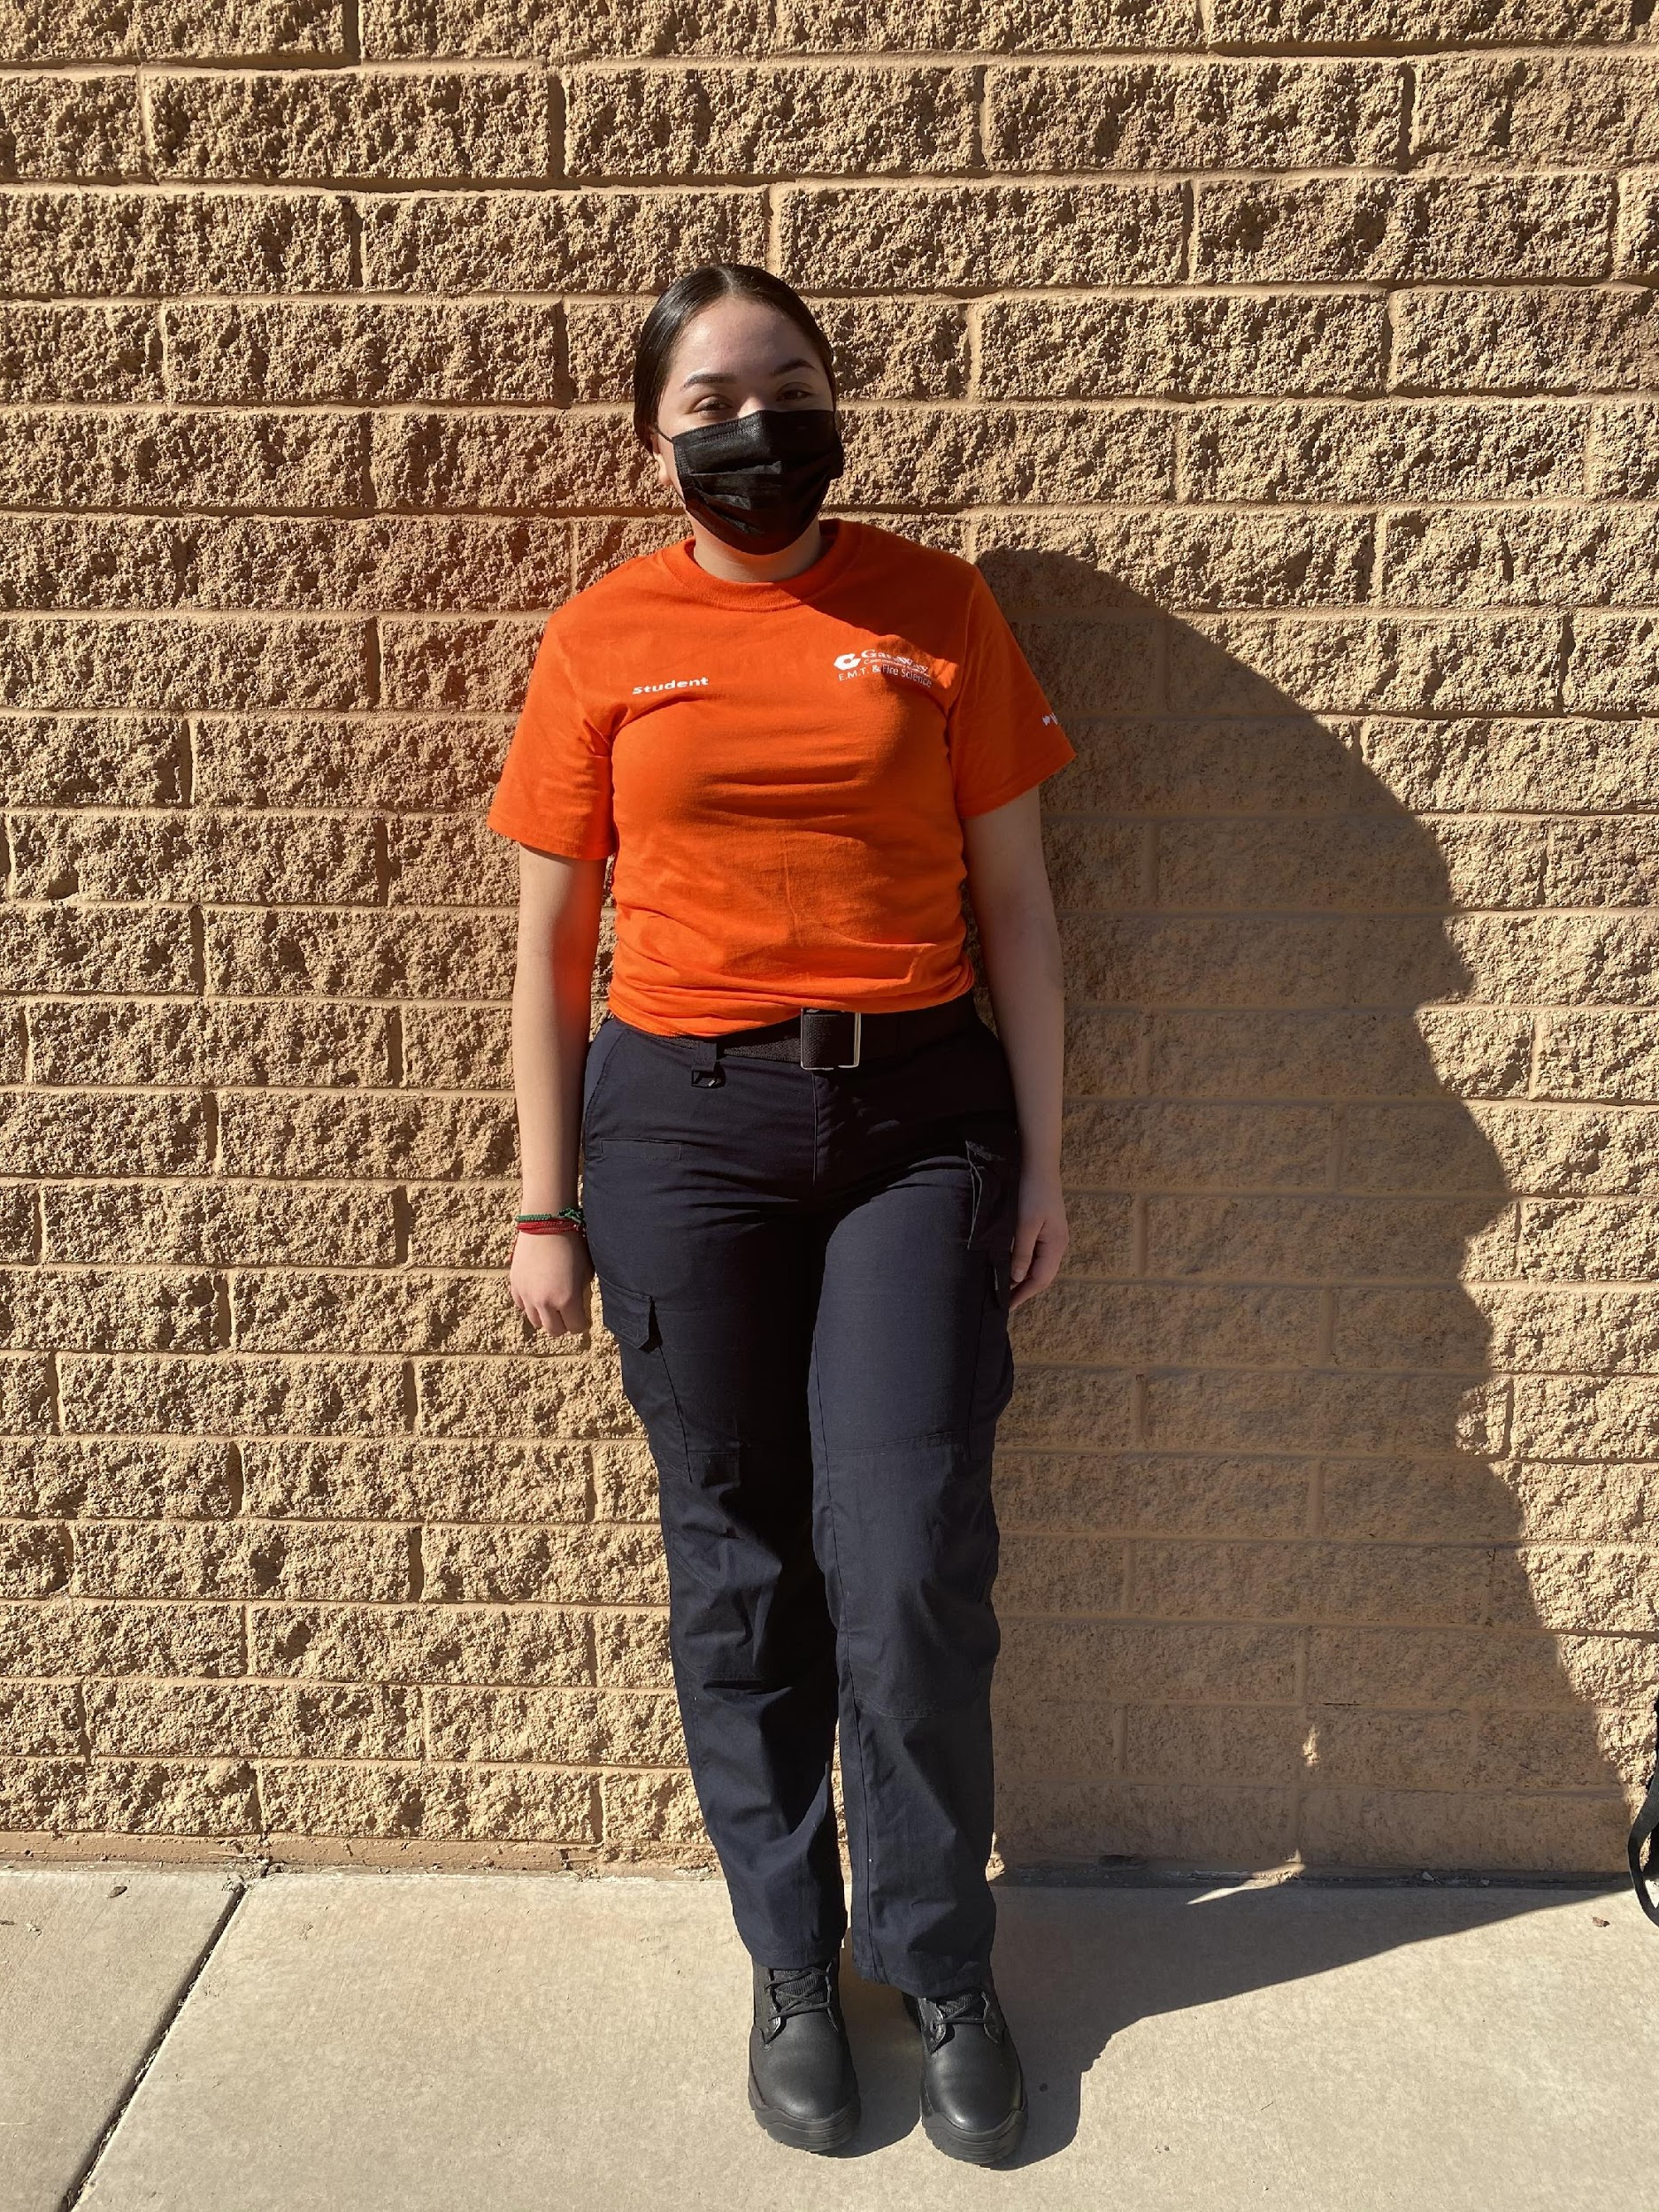
DRESS CODE

Slide 14
DRESS CODE
For uniform shirts, please order from Apparel Pro USA website:
https://www.apparelprousa.com/gateway-emt/students.html
Please note: Hats, jackets or hoodie are ONLY permitted if they have the uniform logo. Alternative to wearing a hoodie is having white/gray/navy blue or black long sleeves to be worn UNDER your uniform shirt. LOGOS MUST BE VISIBLE AT ALL TIMES.

Slide 15
COVID-19 PROTOCOLS
Anyone attending campus in person will be required to:
Display college ID badge or have a photo ID available
Maintain physical distance where possible
Notify their instructor or campus contact if they are not feeling well, and stay home
Routinely monitor their health
Not touch their nose or mouth, and if they do, wash their hands and use hand sanitizer right away
Masks are optional

Slide 16
EMT GRADING SCALE
*An 70% grade or better is required for each EMT course in order to obtain college credit and be eligible to progress to the next higher level course.
**A 65% grade or better is required to obtain high school credit.
Students earn 16 college credits & 2 high school elective credits upon successful completion of course.
Students check their grades through Canvas.
GRADING SCALE
A | 90%-100%
B | 80%-89%
C* | 70%-79%
D** | 65%-69%

Slide 17
GRADES
Fall:
College Transcript:
Students earn letter grades/credits in each college course
High School Transcript:
Students earn one (1) letter grade/one (1) credit reflecting the average of the three (3) college course grades.
Spring:
College Transcript:
Students earn letter grades/credits in each college course
High School Transcript:
Students earn one (1) letter grade and one (1) credit; West-MEC reports the grade earned in one college course.

Slide 18
WITHDRAWALS
Withdrawals from a course will be reflected as follows:
High School transcript grade will show as “W” for withdrawn
College transcript will show as letter grade based on student performance at the time of the withdrawal.

Slide 19
POST-SECONDARY PATHWAYS
Students earn 16 college credits
College credits transfer seamlessly into AA and Bachelor degrees
Information maintained on the West-MEC website.
Check out our 90-30 pathway with NAU!

Slide 20
TECHNOLOGY
Success in the program depends upon the student having access to reliable personal computer and internet outside of class to complete assignments and tests.
If you are in need of a device, please contact West-MEC at speranta.klees@west-mec.org
Limited availability of loaner devices
Student and parent must check out in person from West-MEC District Office or Campus

Slide 21
CTSO
EMT Students are encouraged to participate/compete in HOSA at their home High School.
Contact your school’s HOSA advisor and consider competing in an EMT event.

Slide 22
EMT Students are encouraged to apply for NTHS.
3.0 min. GPA at High School
B or higher in EMT
CTSO, Volunteer, or Leader of Organization
Outstanding Conduct
Applications and documentation: March, Induction Ceremony
Stoles are worn at Recognition Ceremony

Slide 23
POST-SECONDARY PATHWAYS
Students earn 16 college credits in EMT
Students may check their grades through Canvas
College credits transfer seamlessly into AA and Bachelor degrees. Students currently in the 11th grade are invited to apply for the West-MEC Fire Science Program in October 2023 to advance in this pathway and earn another 14 credits

Slide 24
CONDUCT
High expectations for professional conduct
Maturity level on par with industry
Cell phone usage based on campus policy
Conduct concerns will be communicated to students directly by GWCC
College discipline guidelines apply, if student fails to comply with the rules and regulations

Slide 25
BULLYING
It is the right of every student to be educated in a positive, safe, caring and respectful learning environment.
A school environment inclusive of these traits maximizes student achievement, fosters student personal growth, and helps students build a sense of community that promotes positive participation.
Bullying, harassment or intimidation will NOT be
tolerated at West-MEC.

Slide 26
SPECIAL SERVICES
Students with an IEP or a
504 Accommodation Plan and/or
health conditions are expected
to self-advocate.
Students must seek the
Community College Disability Coordinator
for intake and an individualized plan.

Slide 27
FEES
West-MEC Registration Fee - $125.00 VS. $1,737 MCCD Tuition/Fees
MCCD charges West-MEC tuition after students attend Day 1
NO Registration Fee refunds after Day 1 of school.
Reminder- disregard any emails from college re tuition
PARKING

Slide 28
CERTIFICATION
CPR
NIMS
&
National Registry
Emergency
Medical Technicians

Slide 29
EMPLOYMENT
& wages for entry level EMT
Hospital (ER) $40K
Ambulance $38-50K
Doctor’s Office $40-50K
Firefighter $40-50K
Wildland Fire $60K

Slide 30
WEST-MEC GRANTS
Transportation:
College Textbooks:
https://west-mec.edu/parent-resources/

Slide 31
COMMUNICATION
When notified by instructors, program director or GWCC leadership, West-MEC staff will communicate concerns regarding grades, attendance, or behavior to parents and high school counselor or administrator.
Students and parents, please set up phone to accept calls & voicemail and check messages daily. Call back promptly. Check email and respond professionally.
West-MEC Student Services:
speranta.klees@west-mec.org
623-738-0018

Slide 32
QUESTIONS?
Daniel Davis- Assistant Program Manager at GWCC
daniel.davis@gatewaycc.edu
Speranta Klees- Post Secondary Program Manager
speranta.klees@west-mec.org

